Slide 1


Building a cybersecurity educational eco-system for small enterprises
AEEE Conference Freiburg | 8th of October 2021
Jessica Peichl | Bernd Remmele
This project has received funding from the European Union’s Horizon 2020 research and innovation programme under grant agreement No 883588.

Slide 2
Who has already experienced or knows someone who has experienced a cyber attack…
… in personal context?
… in business context?
Who is not afraid of cyber attacks?

Slide 3
Cybersecurity in Europe’s MSEs
Micro and Small Enterprises (MSEs) represent 98.9% of the European enterprises.
They are not sufficiently protected against negligent behaviour and malicious attacks.
60% of small businesses experienced a breach or attack ¹
43% of cyber attacks target small businesses ²
More than 77% of organizations do not have a Cyber Security Incident Response plan ²
60% of MSEs go out of business within six months after a severe cyber attack³
¹ https://assets.kpmg/content/dam/kpmg/pdf/2016/02/small-business-reputation-new.pdf
² https://www.cybintsolutions.com/cyber-security-facts-stats/
³ https://cybersecurityventures.com/60-percent-of-small-companies-close-within-6-months-of-being-hacked/

Slide 4
Cybersecurity in Europe’s MSEs
Increasing digitisation within MSEs leads to growing risks in cybersecurity:
Technological aspects: security state of IT-components
The ‘human factor’: behaviour and knowledge of staff

Slide 5
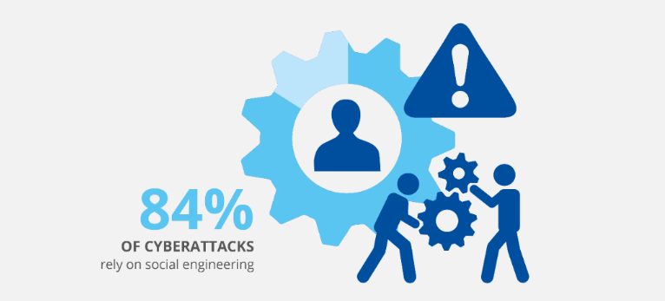
Cyber-attacks often benefit from human behaviour as the weakest link in the IT-security!
Particularly if there is no dedicated IT department like in most small enterprises
https://www.enisa.europa.eu/topics/threat-risk-management/threats-and-trends/etl-review-folder/etl-2020-main-incidents

Slide 6
Consequences for Entrepreneurship Education
If planning and managing – e.g. – the financial viability of a business is part of entrepreneurial competences, shouldn‘t nowadays the digital viability be part as well?
This does not only imply one‘s own knowledge/behaviour as entrepreneur but also that of staff.
Thus human resource management needs to include cybersecurity as well.

Slide 7
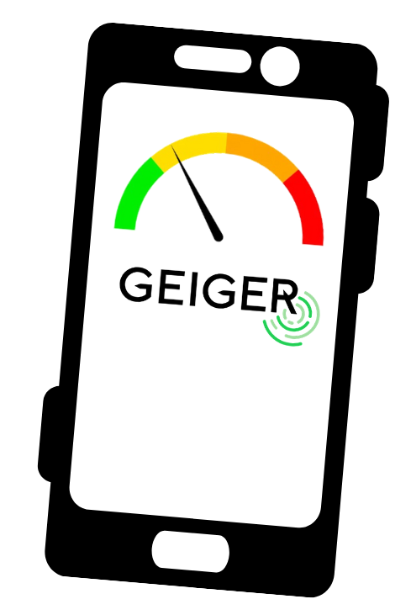
GEIGER – Horizon 2020 EU-funded Project
Goal of helping small businesses within Europe face their cybersecurity challenges
Integration of a technological approach with an educational eco-system aimed at MSEs

Slide 8
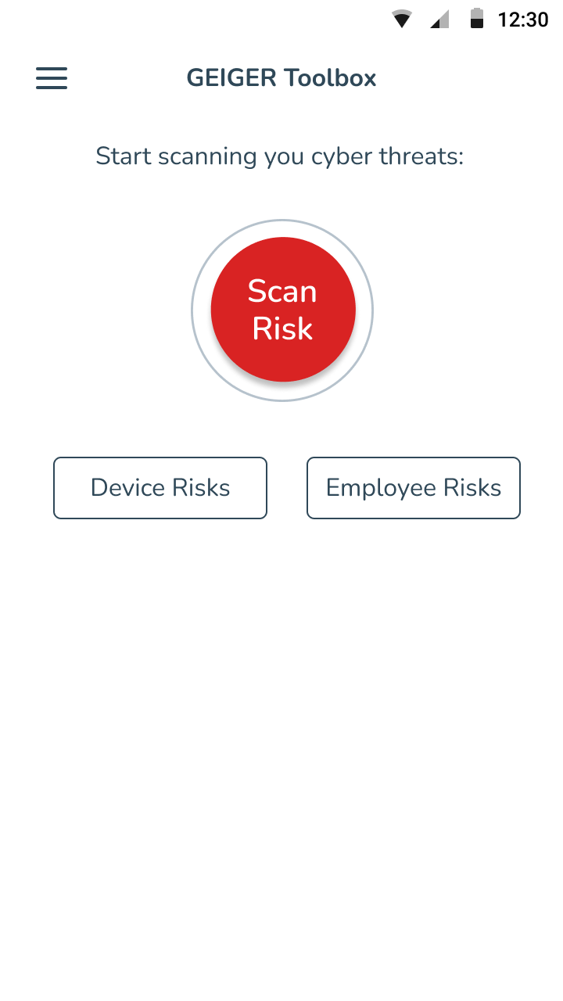
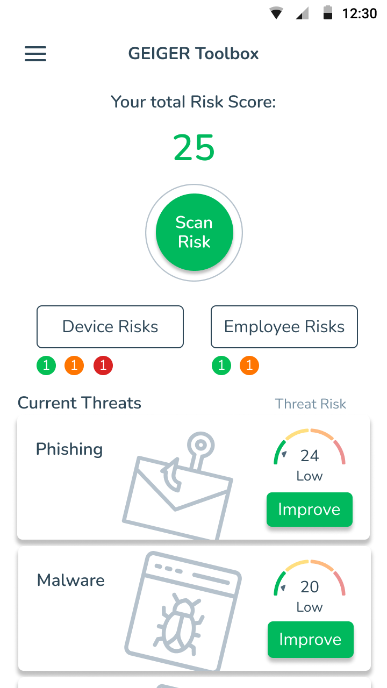
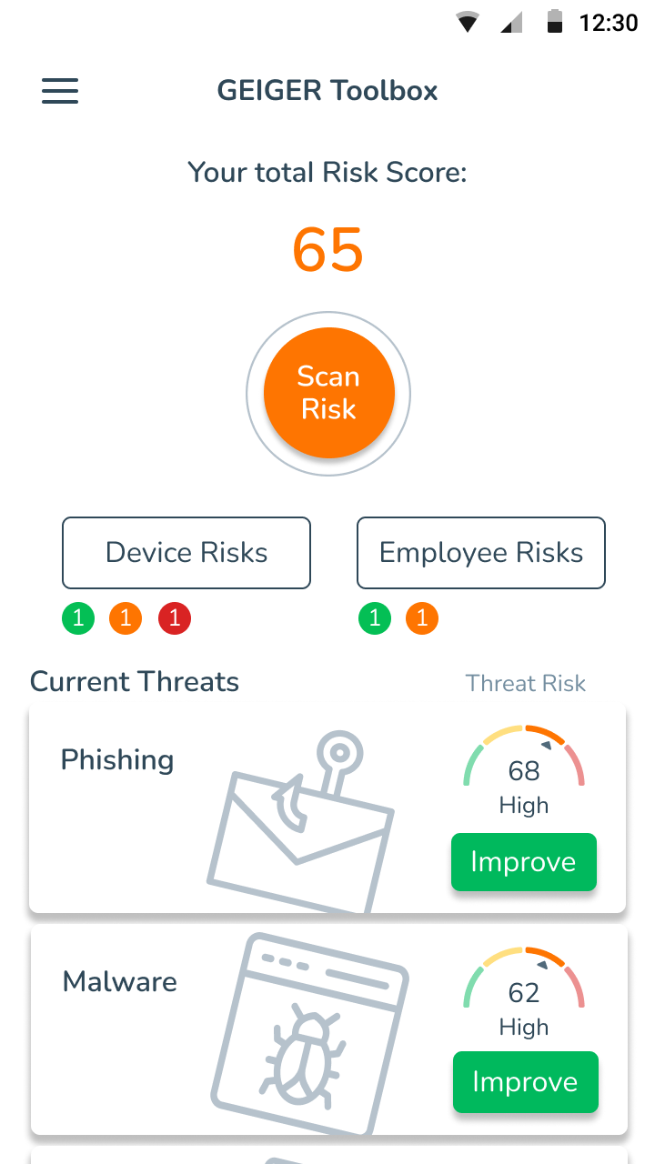
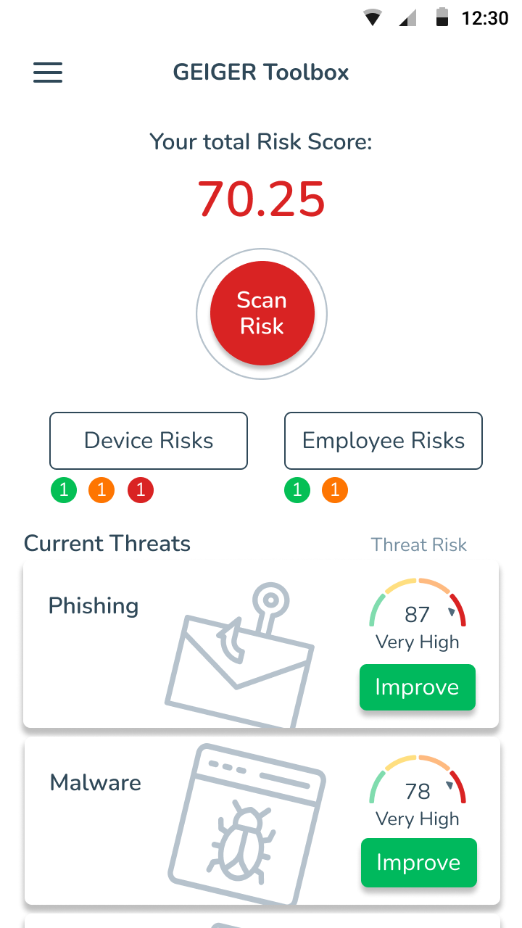
Technological Approach: GEIGER indicator

Slide 9
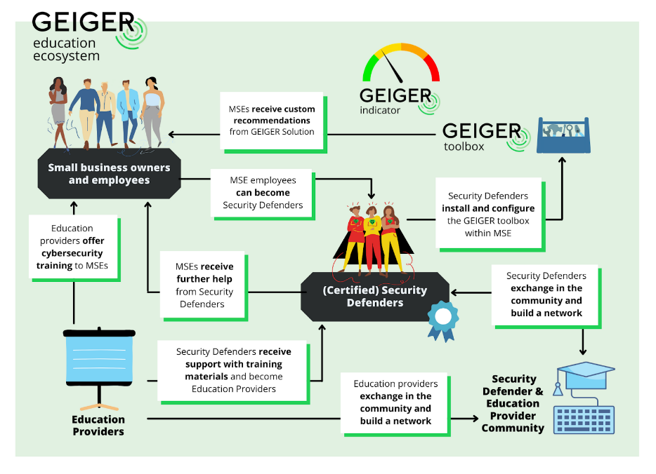
‘human factor’ approach: GEIGER educational eco-system
MSE-specific target groups:
From IT-lay persons to designated persons that will ensure cybersecurity within their own or other MSEs
Learning scenarios:
Self-regulated learning within the GEIGER App
Courses offered by Education Providers, e.g. MSE associations

Slide 10
Curriculum: dimensions
Levels of competence
Level 0 - Basic Cybersecurity
Topical pillars
Cybersecurity awareness, incl. cyber-secure behavior
Knowledge about GEIGER
Object layers
Phishing
….
Level 1 - General MSE-Related Cybersecurity
Level 2 - Advanced MSE-Related Cybersecurity
Level 3 - MSE-Related Cybersecurity Proficiency
Level 4 – IT Specialist
Interaction with other users of GEIGER
Identity Theft
Malware
DDoS
Ransomware
Web-based Attacks
Physical Manipulation
GDPR

Slide 11
Competence levels
Competence level | Objective | Learning environment
Level 0 - Basic Cybersecure Behaviour | Everyday issues of cyber-security | everyday incidental learning
Level 1 - General MSE-Related Cybersecure Behaviour | General set of business-related cyber-security issues, relevant for IT-lay employees | situated learning in business-context: Self-regulated learning Course based learning
Level 2 - Advanced MSE-Related Cybersecure Behaviour | Broad set of MSE-specific cyber-security issues, relevant for IT-lay employees of MSEs | organised instruction: course-based learning
Level 3 - MSE-Related Cybersecurity Proficiency | Advanced and coherent set of MSE-specific cyber-security issues, relevant for the person monitoring the IT-ecosystem of an MSE | expert-lead instruction: - course-based learning
Level 4 – IT Specialist | Handling of GEIGER within an MSE | expert-lead instruction: – course-based learning

Slide 12
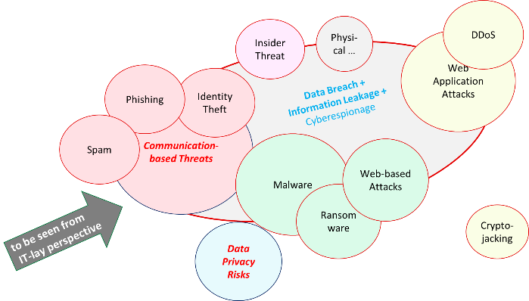
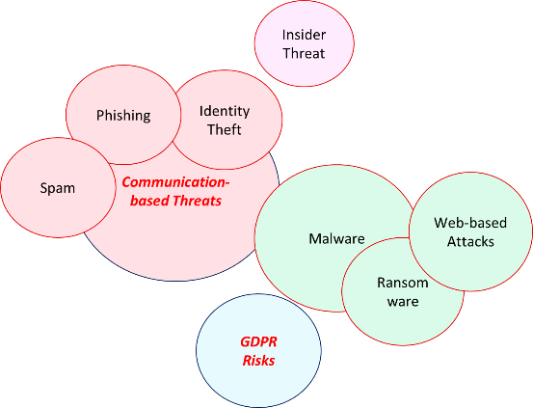
Cybersecurity education topics – threat landscape
Based on recommendations of European Union Agency for Cybersecurity (ENISA)
All ENISA threats:
MSE employee perspective
Adaption for non-IT MSE employee perspective

Slide 13
From competence grid and threat landscape to curriculum
Competence level | Objective | Learning environment
Level 0 - Basic Cybersecure Behaviour | Everyday issues of cyber-security, mainly relate to internet-based communication and the usage of passwords | acquirable through everyday incidental learning
Level 1 - General MSE-Related Cybersecure Behaviour | General set of business-related cyber-security issues, relevant for IT-lay employees | acquirable through situated learning in business-context
Level 2 - Advanced MSE-Related Cybersecure Behaviour | Broad set of MSE-specific cyber-security issues, relevant for IT-lay employees of MSEs. | acquirable through organised instruction, e.g. through in-house training
Level 3 - MSE-Related Cybersecurity Proficiency | Advanced and coherent set of MSE-specific cyber-security issues, relevant for the person monitoring the IT-ecosystem of an MSE | acquirable through expert-lead instruction, i.e. specialized cybersecurity courses
Level 4 – IT Specialist | Handling of GEIGER within an MSE | specialized GEIGER courses
How to

Slide 14
…to be continued!
Cybersecurity as a relevant skill for managers and staff
Educational approach and adapted for MSE-specific needs in terms of levels and content (current threats)
Cybersecurity as a future competence in Entrepreneurship Education?

Slide 16
 | Cybersecurity awareness | How to DO | How to COMMUNICATE
Level 0 | Limited, random everyday knowledge of some issues of cybersecurity | n.a. | n.a.
Level 1 | General knowledge of a relevant set of cybersecurity issues and of basic rules of cyber-secure behaviour | n.a. | n.a.
Level 2 | MSE-specific knowledge of a relevant set of cybersecurity issues and of basic rules of cyber-secure behaviour | General knowledge about GEIGER | Ability to communicate cybersecurity and the general relevance of GEIGER for it within an MSE context
Level 3 | MSE-specific understanding of a coherent set of cybersecurity issues and application of principles-based rules of cyber-secure behaviour within typical MSE environments | Detailed knowledge about GEIGER and its application within a (one) specific MSE | Ability to explain (mentor) the specific cybersecurity aspects of the given MSE and how GEIGER works in it
Level 4 | MSE-specific understanding of a coherent set of cybersecurity issues and analysis of cyber-secure behaviour | Detailed understanding of GEIGER and its application within most MSE usage environments | Ability to train for level 3 as well as 1 and 2 respectively

